Slide 1



Moments in Statistics
DR. HEENA SHARMA
E6398
ASSISTANT PROFESSOR
CSE
DISCOVER . LEARN . EMPOWER

Slide 2
Moment System
Sub group of measurement of central tendency i.e. variability and skewness.
Includes measurement like mean, average deviation, standard deviation and so on.
It is analogous to the term ‘Moment’ used in physics.
Size of class intervals represent the force and deviation of mid value of each class from he observation represent the distance.
Moments basically represents a convenient and unifying method for summarizing certain descriptive statistical measures.

Slide 3
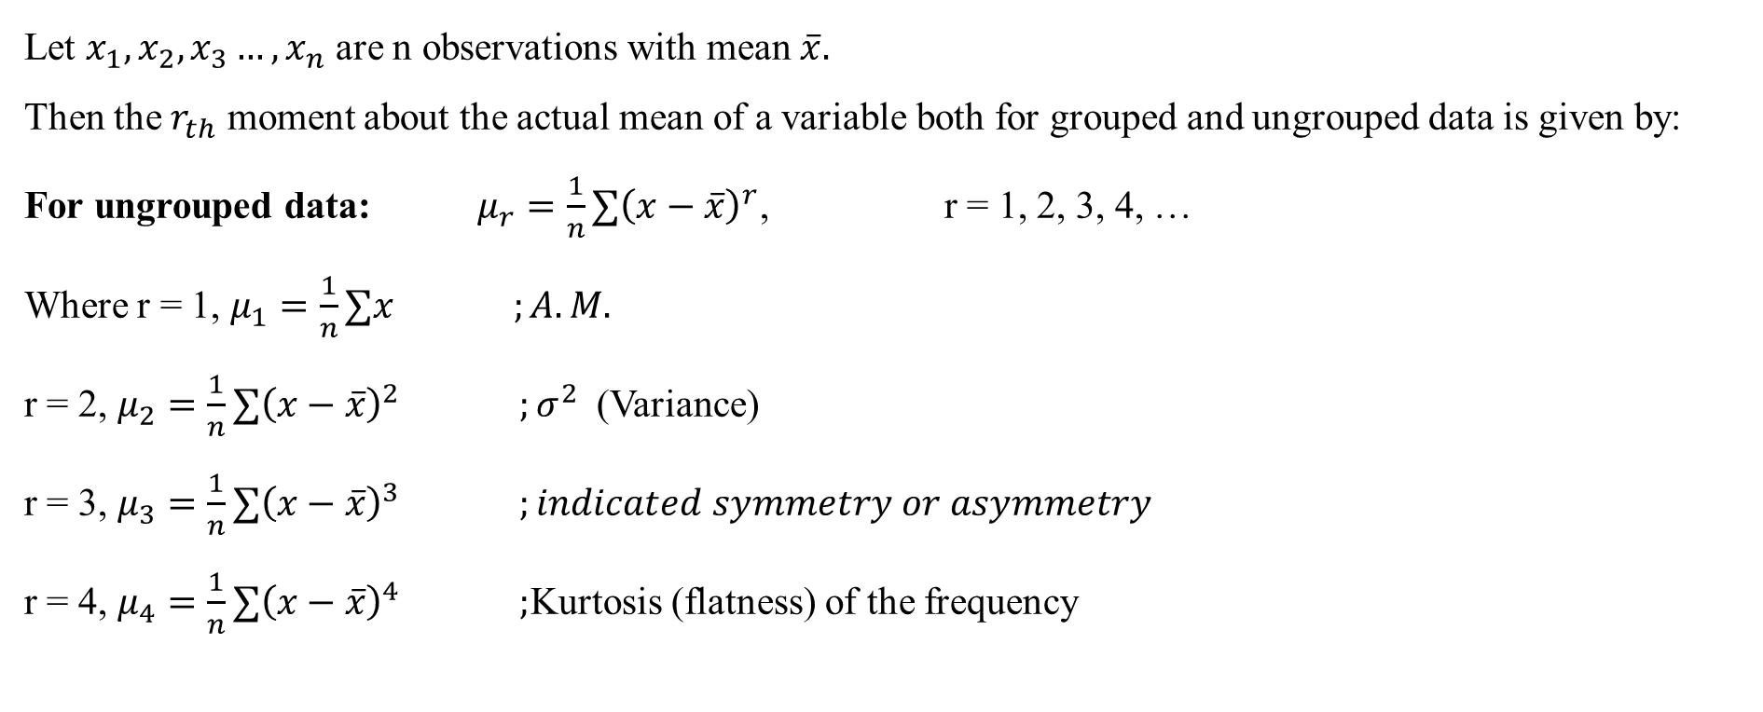
Moments about Mean
Let $x_{1},x_{2},x_{3}…,x_{n}$ are n observations with mean $\overline{x}.$
Then the $r_{th}$ moment about the actual mean of a variable both for grouped and ungrouped data is given by:
For ungrouped data: $μ_{r}=\frac{1}{n}∑{\left(x−\overline{x}\right)}^{r}$, r = 1, 2, 3, 4, …
Where r = 1, $μ_{1}=\frac{1}{n}∑x ;A.M.$
r = 2, $μ_{2}=\frac{1}{n}∑{\left(x−\overline{x}\right)}^{2} ;σ^{2}$(Variance)
r = 3, $μ_{3}=\frac{1}{n}∑{\left(x−\overline{x}\right)}^{3} ;indicated symmetry or asymmetry$
r = 4, $μ_{4}=\frac{1}{n}∑{\left(x−\overline{x}\right)}^{4} ;$Kurtosis (flatness) of the frequency

Slide 4
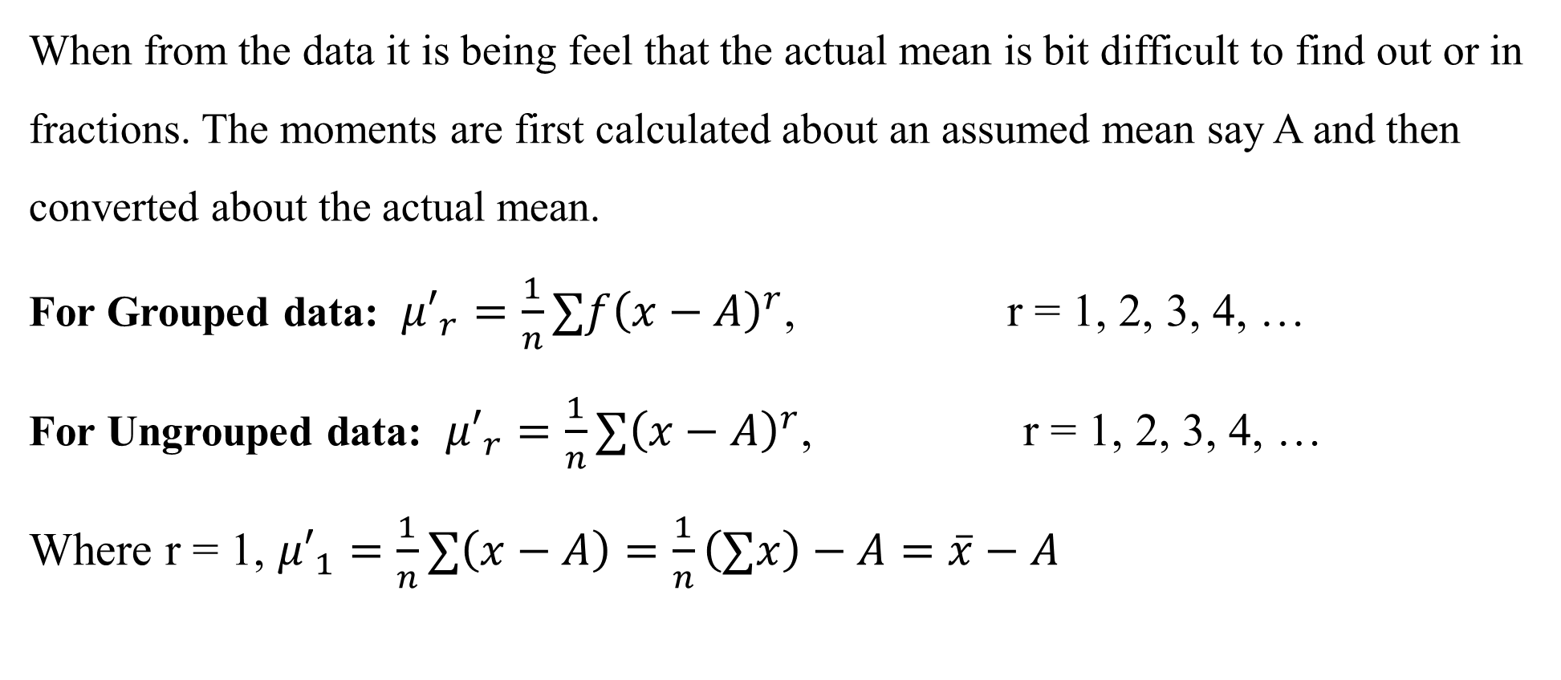
Moments about Arbitrary Points
When from the data it is being feel that the actual mean is bit difficult to find out or in fractions. The moments are first calculated about an assumed mean say A and then converted about the actual mean.
For Grouped data: ${μ′}_{r}=\frac{1}{n}∑f{\left(x−A\right)}^{r}$, r = 1, 2, 3, 4, …
For Ungrouped data: ${μ′}_{r}=\frac{1}{n}∑{\left(x−A\right)}^{r}$, r = 1, 2, 3, 4, …
Where r = 1, ${μ′}_{1}=\frac{1}{n}∑\left(x−A\right)=\frac{1}{n}\left(∑x\right)−A=\overline{x}−A$

Slide 5

Relation Between Central Moments and Moments about any Arbitrary Points
$μ_{1}={μ′}_{1}$
$μ_{2}={μ′}_{2}−{\left(μ_{1}^{′}\right)}^{2}$
$μ_{3}={μ′}_{3}−3μ_{2}^{′}μ_{1}^{′}+2{\left(μ_{1}^{′}\right)}^{3}$
$μ_{4}={μ′}_{4}−4μ_{3}^{′}μ_{1}^{′}+6μ_{2}^{′}{\left(μ_{1}^{′}\right)}^{2}−3{\left(μ_{1}^{′}\right)}^{4}$

Slide 6

Moments about Zero or Origin
The moments about zero or origin are obtained as follows:
$V_{r}=\frac{1}{n}∑{f\left(x\right)}^{r}$, r = 1, 2, 3, 4, …
The first moment about origin gives the mean
$V_{r}=\frac{1}{n}∑fx$ ; A.M.

Slide 7
THANKS FOR PAYING ATTENTION
Please Send Your Queries on:
e-Mail: heena.e6398@cumail.in

